Slide 1
POULTRY SCIENCE: Poultry Evaluation
Unit 7

Slide 2
What is Poultry Evaluation?
Click here for National FFA Poultry Evaluation Video!

Slide 3
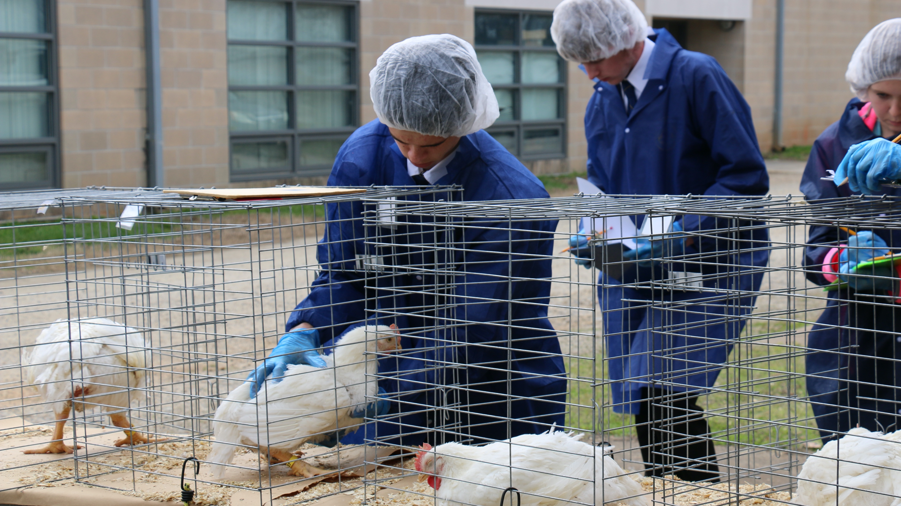
Poultry Evaluation Resources
PowerPoint Resources for Teaching Contest Classes
Videos Explaining Classes & Evaluation (Please keep in mind some information could be outdated as the contest evolves over time.)
*Potential* Practice Poultry Evaluation Contest Resources: Quizlets and AU PDF
Please remember to refer to the most updated version of GA FFA Association Contest Rules and adjust accordingly.

Slide 4
Poultry Science Curriculum References
Jessica Fife, UGA Dept. of Poultry Science Outreach Coordinator, UGA Dept. of Agricultural Leadership, Education, & Communication MAEE Candidate
Barry Croom, UGA Dept. of Agricultural Leadership, Education, & Communication Professor
Ashley Yopp, UGA Dept. of Agricultural Leadership, Education, & Communication Assistant Professor
Georgia Agriculture Education
Andrew Benson, UGA Dept. of Poultry Science Assistant Professor
Brian Jordan, UGA Dept. of Poultry Science Assistant Professor, UGA College of Veterinary Medicine Assistant Professor
University of Arkansas Bumpers College of Poultry Science – Poultry Science Dual Curriculum Course
Julia Gaskin, UGA Dept. of Crop and Soil Sciences Sr. Public Service Associate
Glendon Harris, UGA Dept. of Crop and Soil Sciences Professor & Extension Agronomist
Brian Kiepper, UGA Dept. of Poultry Science Associate Professor
Claudia Dunkley, UGA Dept. of Poultry Science Public Service Associate
Casey Ritz, UGA Dept. of Poultry Science Professor
USPOULTRY & USPOULTRY Poultry Science Curriculum
Tom Tabler, Mississippi State University Department of Poultry Science Extension Professor
Jacquie Jacob, University of Kentucky
Jeanna Wilson, UGA Dept. of Poultry Science Professor
Kelly Sweeney, UGA Dept. of Poultry Science Ph.D Candidate
Merck Veterinary Manual
University of Maryland Extension
Poultry Hub
Brian Fairchild, University of Georgia Department of Poultry Science Professor
Centers for Disease Control
National FFA Organization

